Slide 1

Department of Computer Engineering
Standard representations for Logic Functions
(SOP and POS)
1

Slide 2
Points covered
Department of Computer Engineering
Standard representation for logic functions
Canonical SOP and POS
Examples
Minterms/maxterms of three and four variables
Equation using notations in Canonical SOP form
Minterm/maxterm representation in complementary form

Slide 3
Department Vision & Mission
Department of Computer Engineering
Vision
Achieve academic excellence through education in computing, to create intellectual manpower to explore professional, higher educational and social opportunities.
Mission
To impart learning by educating students with conceptual knowledge and hands on practices using modern tools, FOSS technologies and competency skills there by igniting the young minds for innovative thinking, professional expertise and research.
3

Slide 4
Standard representation for logic functions
Department of Computer Engineering
Any logic function can be expressed in the following forms.
Sum-of-products form (SOP)
e.g. AB + AC’ + BC
A, B, C, C’ are called as literals
Product-of-sums form (POS)
e.g. (A + B) (A + C) (B + C’)

Slide 5
Canonical SOP and POS
Department of Computer Engineering
If each term in SOP and POS forms contains all the literals then these are known as canonical SOP and POS respectively.
e.g. The equation Y = ABC + ABC’ + AB’C’ + A’BC in canonical SOP form
The equation
Y = (A + B + C) (A + B + C’) (A + B’ + C) (A’+ B + C’) in canonical POS form
Each individual term in canonical SOP is called as minterm and in canonical POS form as maxterm.
Exercise : Convert AB + AC’ + BC into canonical SOP form

Slide 6
Examples
Department of Computer Engineering
Convert AB + AC’ + BC into canonical SOP form
SOP form can be converted to canonical SOP by ANDing the terms in expression with terms formed by ORing the variable and its complement which are not present in that term.
Y = AB ( C + C’) + AC’ ( B + B’) + BC (A+A’)
Y =ABC + ABC’ + ABC’ + AB’C’ + ABC + A’BC
Y = ABC + ABC’ + AB’C’ + A’BC (Theorem 1.5 A + A = A)

Slide 7
Examples
Department of Computer Engineering
Convert (A + B) (A + C) (B + C’) into canonical POS form
POS form can be converted to canonical POS by ORing the terms in the expression with terms formed by ANDing the variable and its complement which are not present in the term
Y = (A + B + CC’) (A + C + BB’) (B + C’+AA’)
Y = (A + B + C) (A + B + C’) (A + C + B) (A + C + B’)
(B + C’+A) (B + C’+A’) (theorem 1.10 A + BC = (A + B) (A+C))
Y = (A + B + C) (A + B + C’) (A + B’ + C) (A’+ B + C’)

Slide 8
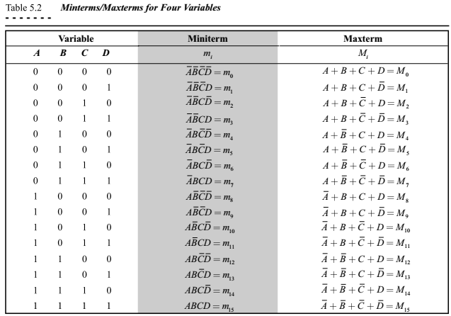
Minterms/maxterms of four variables
Department of Computer Engineering
The number
of minterms and maxterms for a four variable logical function is
2⁴ = 16
Where n=4
Each min term is represented by m_{i}
Where i is decimal equivalent of binary number

Slide 9
Minterms/maxterms of three variables
Department of Computer Engineering
The number
of minterms and maxterms for a three variable logical function is
2³ = 8
Where n=3
Each min term is represented by m_{i}
Where i is decimal equivalent of binary number
Variable |  |  | Minterm | Maxterm
A | B | C | m_{i} | M_{i}
0 | 0 | 0 | A’B’C’=m₀ | A + B + C= M₀
0 | 0 | 1 | A’B’C=m₁ | A + B + C’= M₁
0 | 1 | 0 | A’BC’=m₂ | A + B’ + C= M₂
0 | 1 | 1 | A’BC=m₃ | A + B’ + C’= M₃
1 | 0 | 0 | AB’C’=m₄ | A ‘+ B + C= M₄
1 | 0 | 1 | AB’C=m₅ | A ‘+ B + C’= M₅
1 | 1 | 0 | ABC’=m₆ | A ‘+ B’ + C= M₆
1 | 1 | 1 | ABC=m₇ | A ‘+ B’ + C’= M₇

Slide 10
Equation using notations in Canonical SOP form
Department of Computer Engineering
Y = ABC + ABC’ + AB’C’ + A’BC
Y = Σ(m_{3,} m₄, m₆, m₇)
Y = Σ m (3, 4, 6, 7)
ABC = m₇
ABC’ = m₆
AB’C’= m₄
A’BC = m₃
Variable |  |  | Minterm
A | B | C | m_{i}
0 | 0 | 0 | A’B’C’=m₀
0 | 0 | 1 | A’B’C=m₁
0 | 1 | 0 | A’BC’=m₂
0 | 1 | 1 | A’BC=m₃
1 | 0 | 0 | AB’C’=m₄
1 | 0 | 1 | AB’C=m₅
1 | 1 | 0 | ABC’=m₆
1 | 1 | 1 | ABC=m₇

Slide 11
Equation using notations in Canonical POS form
Department of Computer Engineering
Y = (A + B + C) (A + B + C’) (A + B’ + C) (A’+ B + C’)
= π (M_{0,} M₁ M₂, M₅)
= π M (0,1,2,5)
A + B + C = M₀
A + B + C’ = M₁
A + B’ + C = M₂
A’+ B + C’ = M₅
Variable |  |  | Maxterm
A | B | C | M_{i}
0 | 0 | 0 | A + B + C= M₀
0 | 0 | 1 | A + B + C’= M₁
0 | 1 | 0 | A + B’ + C= M₂
0 | 1 | 1 | A + B’ + C’= M₃
1 | 0 | 0 | A ‘+ B + C= M₄
1 | 0 | 1 | A ‘+ B + C’= M₅
1 | 1 | 0 | A ‘+ B’ + C= M₆
1 | 1 | 1 | A ‘+ B’ + C’= M₇

Slide 12
Minterm/maxterm representation in complementary form
Department of Computer Engineering
Y = π M (0 , 1 , 2 , 5)
And
Y = Σ m (3, 4, 6, 7)
In complementary form
If logic function is specified in term of minterm/maxterm, its maxterm / minterm representation can be determined by using this complementary property.
Y = Σ m (0,3,6,7,10,12,15)
Then Y = π M (1,2,4,5,8,9,11,13,14)

Slide 13
Summary
Department of Computer Engineering
Standard representation for logic functions
Canonical SOP and POS
Examples
Minterms/maxterms of three and four variables
Equation using notations in Canonical SOP form
Minterm/maxterm representation in complementary form

Slide 14
Department of Computer Engineering
Thank you

